Slide 1

Cal Woodruff
David Zhou
Vik Kumar
Wilson Huynh

Slide 2

Volunteer Management System
Organizations can manage, advertise, and schedule
Volunteers can search for and keep a history or volunteer jobs

Slide 3

High turnover rate
Costly scheduling
Inconvenient tracking
Unverified volunteer work references
Searching for volunteer opportunities

Slide 4

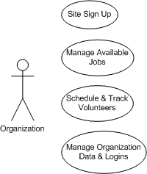
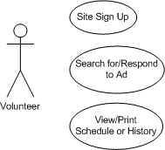
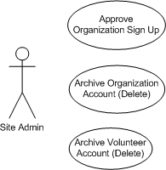

Slide 5

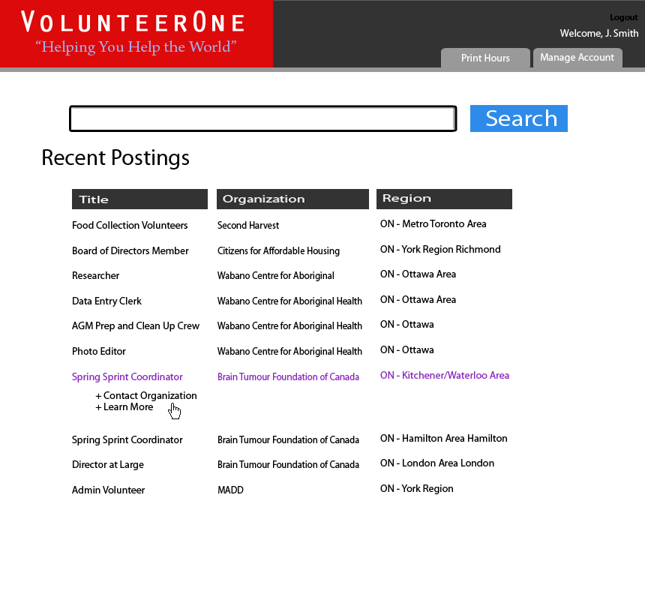


Slide 6
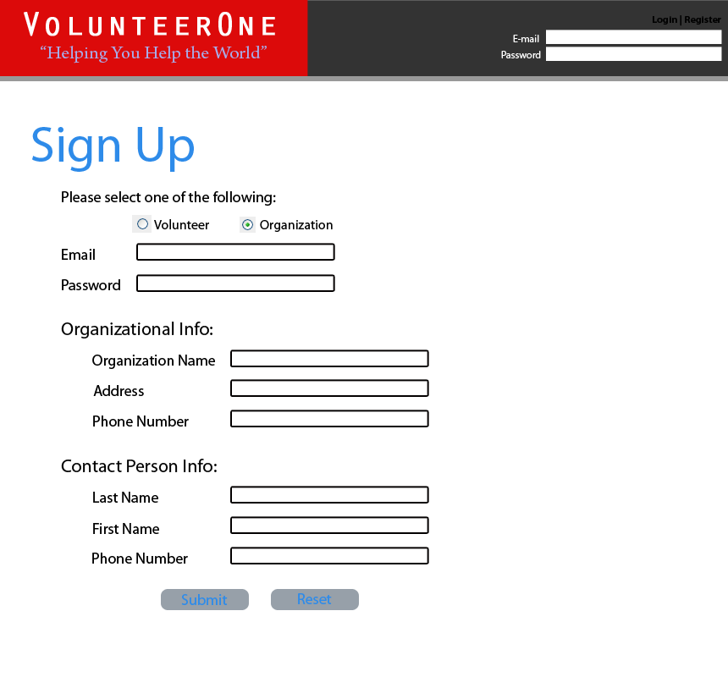

Slide 7
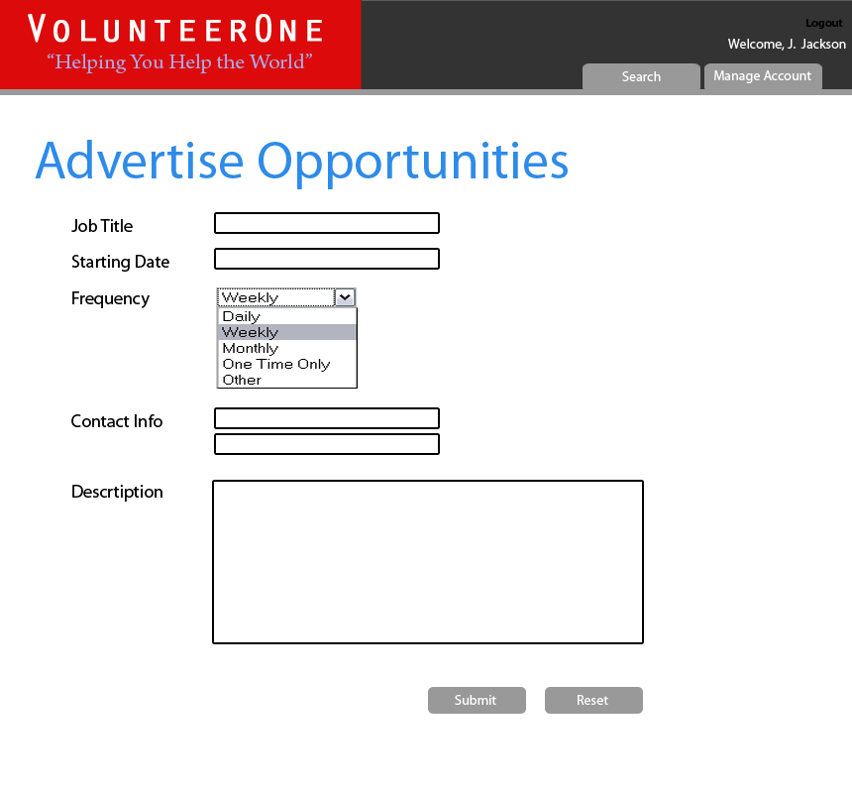

Slide 8
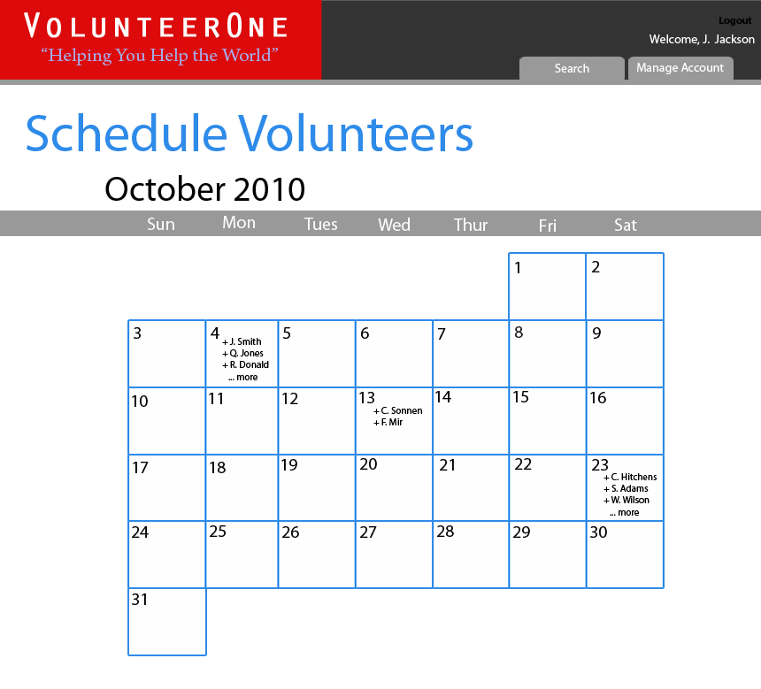

Slide 9
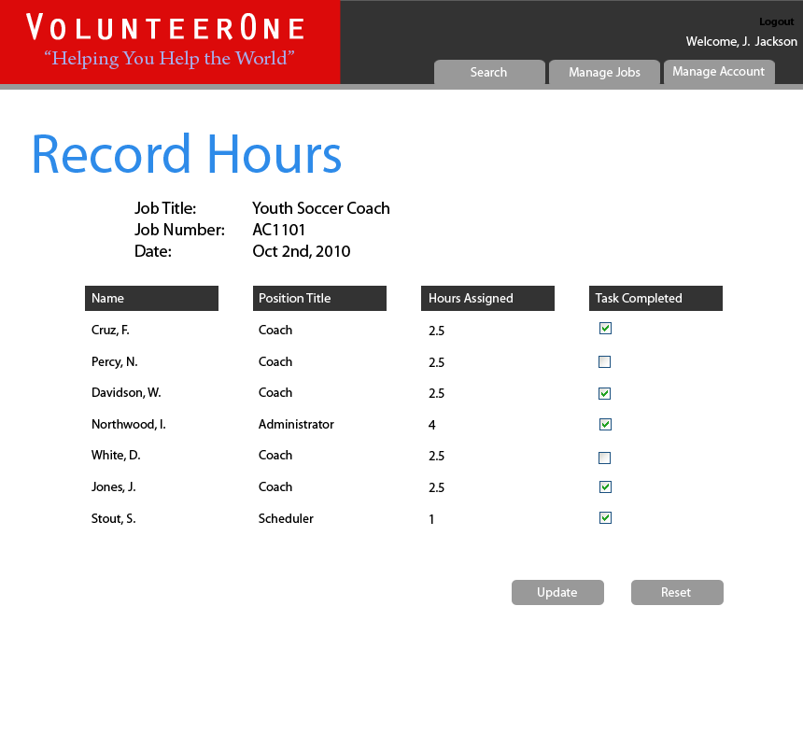

Slide 10
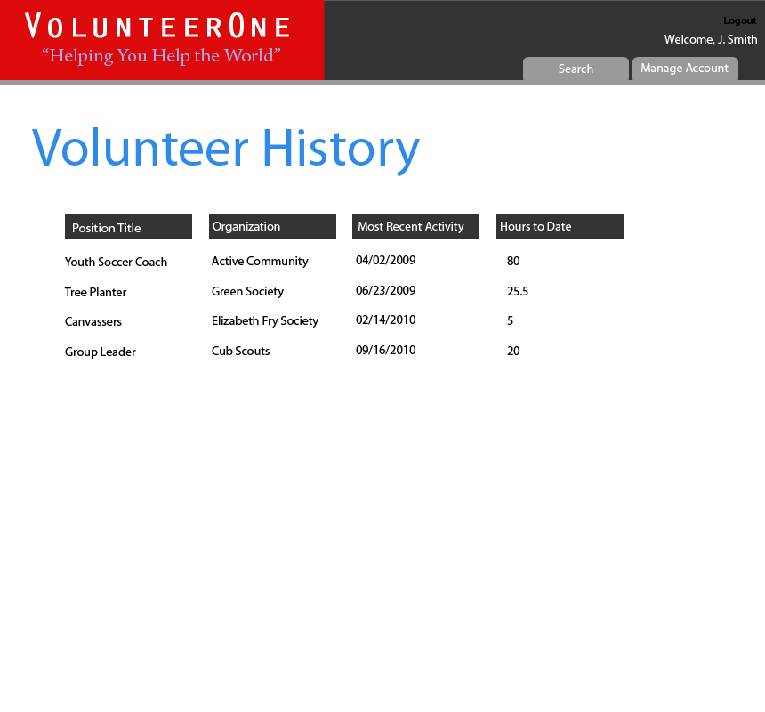

Slide 11
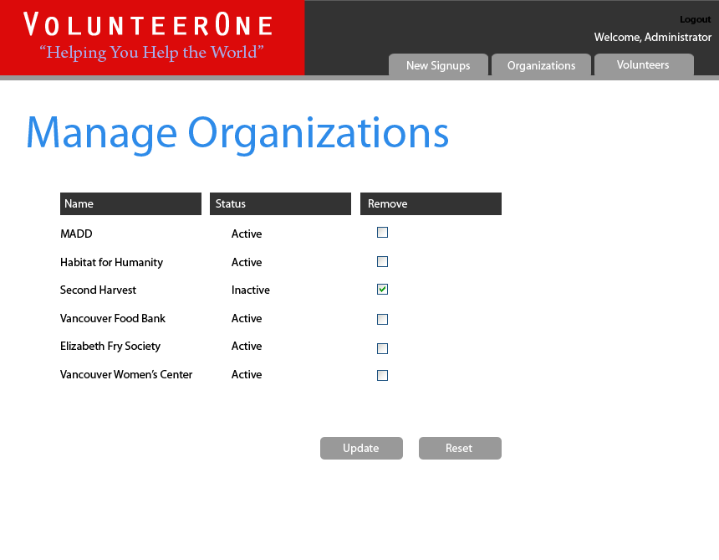

Slide 12

Analyzing & designing database model
Look and relationships of the site pages
Usability testing and deployment
MySQL
PHP
jQuery(Javascript)
Smarty Templates(PHP)
Custom Framework

Slide 13

8 Hours per week for 4 weeks
Database design: 10 hours
Visual site design: 20 hours
Code / Test / Deploy cycle: 80 hours
Documentation: 18 hours
DB of postings, accounts and schedules
Website and support tools
Project documentation

